Slide 1
COMPUTATIONAL PHYSICS
BY:
V BALADITYA AIE22064
VINITHA CHOWDARY A AIE22066

Slide 2
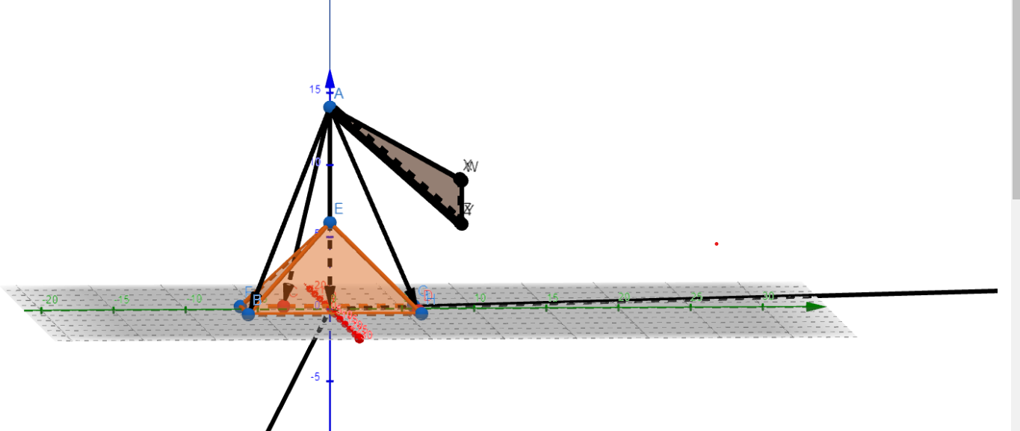
QUESTION 1:
A pyramid shaped metal container weighing 3500 N is held by three ropes suspended from a crane.
We find the tension in the three ropes AB, AC and AD.
We also find the moment of force about the point A

Slide 3
Assuming the co-ordinates of A(0,0,14) , B(5,-6,0) , C(-3,-3,0) , D(2,6,0)
Finding the unit vectors along AB , AC , AD using the co-ordinates of A , B , C and D.
Finding the tension in the three strings using inverse of a matrix.
Finding the momentum using the resultant tension vector and the OA.

Slide 4
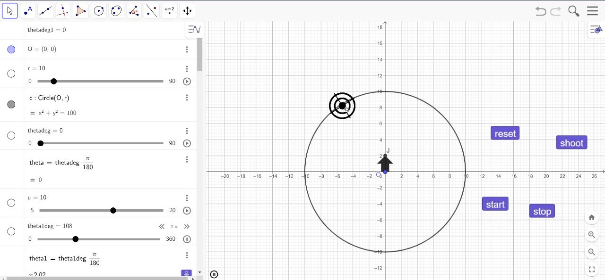
QUESTION 2:

Slide 5
A target is revolving with a constant speed around an arrow , the arrow needs to hit the target.
The target starts its rotation when the “start” command and the target stops its rotation by the “stop” command
The arrow is shot with the help of “shoot” button.
To reset the position of the arrow the “reset” command is used.
When the arrow enters the range of the target: “HIT!!” gets displayed.
The user has to reset the position of the arrow after one trial.
.

